Slide 1

Task 2-Predicting Customer Behaviour
By
Mathavan S G

Slide 2
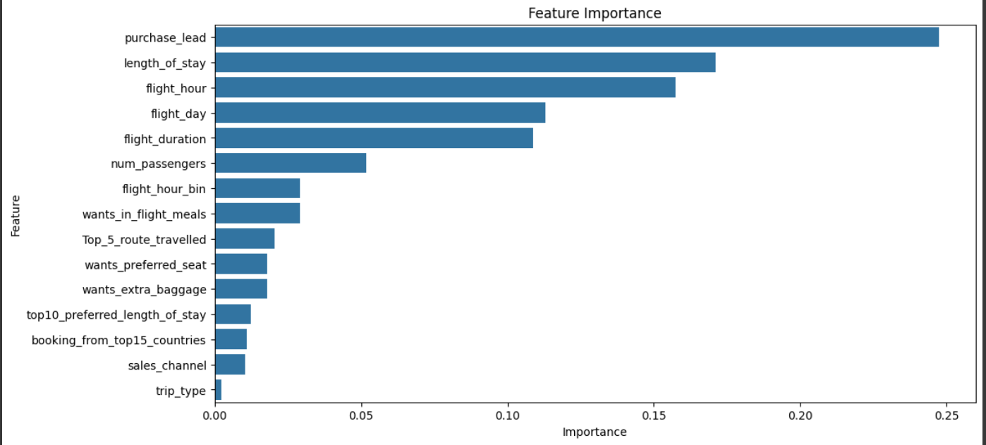
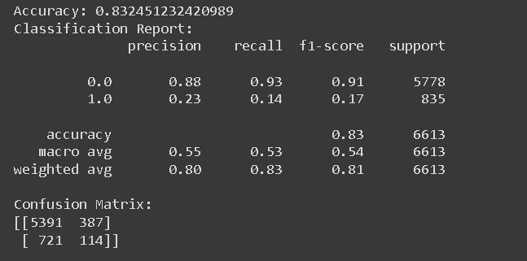
Predictive Model To Understand Factors That Influence Buying Behaviour
Feature | Importance
purchase_lead | 0.247536
length_of_stay | 0.171102
flight_hour | 0.157532
flight_day | 0.112936
Flight_duration And so on. | 0.108698
Model is performing quite good in predicting the customer not buying still it need improvement on finding the customer who tends to buy by feature engineering with domain knowledge

